Slide 1


numerical Methods
Notes:
Note: After adding your pictures, right click on it and “Send To Back”.

Slide 2

Introduction

Slide 3

Oorganization:
Lecture: 20/16 meetings discussion of numerical method
During the lecture the basic computing environment will be the Matlab program from MathWorks.
During the course there will be two small tests and five homework assignments for assessment and final exam

Slide 4
What Numerical Methods or Analysis are?
Numerical methods are algorithms that work well in solving mathematical problems where analytical methods fail, i.e.:
• analytical solution does not exist,
• the analytical solution is very difficult to achieve.
Numerical methods have been proposed over the last centuries:
• Newton, Lagrange, Fourier, Raphson (17th-18th centuries),
• Euler, Simpson (18th century),
• Gauss, Krylov (18th-19th centuries),
• Chebyshev, Jacobi (19th century).

Slide 5
What Numerical Methods or Analysis are?
The most effective use of numerical methods came with power of computational intelligence of computers (from 1950s).
Meeting with numerical analysis algorithms is almost 100% shure in the future engineer's work.

Slide 6
What Numerical Methods or Analysis are?
From the student's point of view, Numerical Methods are ideal training material for those willing to acquire coding skills in computing environments (data analysis and processing).
Understanding and ability to implement algorithms such as interpolation, approximation, numerical solution of differential equations, numerical integration, they are also an ideal base for further learning about computational intelligence methods.

Slide 7
What Numerical Methods or Analysis are?
Most numerical methods are available as ready-made implementations provided by software developers or external libraries in the form of a ready-made function, e.g. fft(), interp(), polyfit(), etc.
Most numerical methods are used in image processing systems,
sound (signals), data analysys etc.

Slide 8
What Numerical Methods or Analysis are?
During the course, students acquire the ability to implement algorithms in the form of computational code (these are not programs in the literal sense), i.e. they learn:
• theoretical foundations of the numerical problem,
• preparing the calculation code that implements the given task (home works),
• testing the prepared code and its repeated use in the given conditions

Slide 9
How can we divide mathematical calculations?
Symbolic
Numerical

Slide 10
Type of math calculation
Symbolic calculations – these are those that result in functions and expressions in the form symbolic, using symbolic variables (x, y, etc.), e.g. solving the integral undefined, determination of derivative functions, Laplace and Fourier transformations (in general wherever we do not deal with numerical values while solving, but looking “form” of a function)

Slide 11
Type of math calculation
Numerical calculations – these are those in which the main computational instrument is itself numbers. Numerical calculations replace symbolic ones, providing solutions to approximate (iterative methods) or calculate certain issues directly: elimination Gauss, Cramer's method, Householder transformation. A solution to the numerical method are numerical values.

Slide 12

The example of symbolic calculations
Try solv this:
$${\left.\frac{∂}{∂x}\left(5x^{3x^{x}}\right)\right|}_{x=0.5}$$

Slide 13
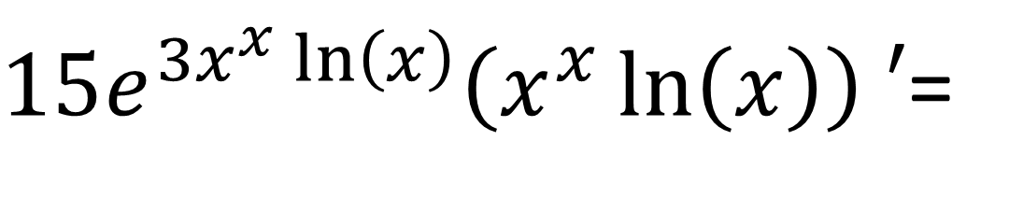
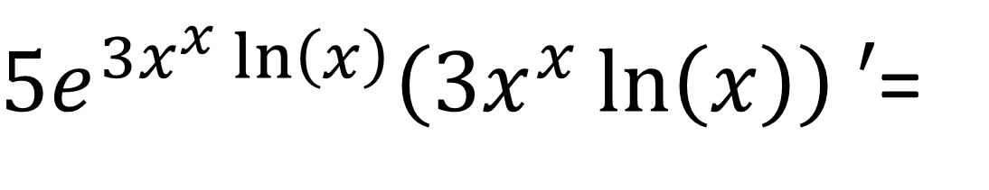
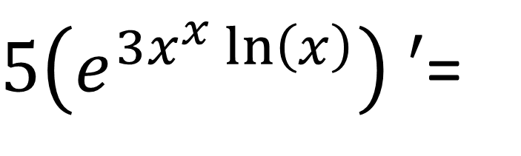

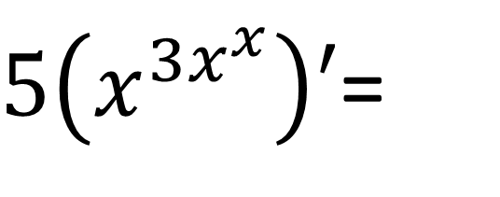
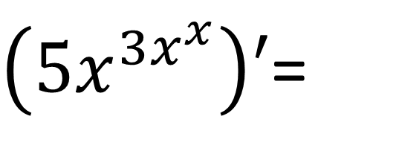
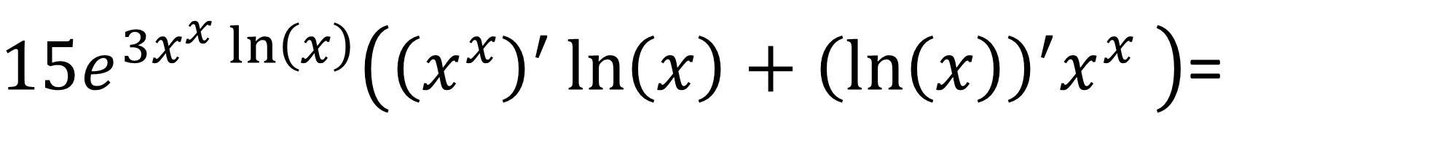
$${\left.\frac{∂}{∂x}\left(5x^{3x^{x}}\right)\right|}_{x=0.5}$$
Symbolic / analitic solution:
We can use the Euler trnsformation, dirivative of internal function and severa others transformation:
$\left(5x^{3x^{x}}\right)′$=
$5\left(x^{3x^{x}}\right)′$=
$5\left(e^{3x^{x}\ln\left(x\right)}\right) ′$=
$5e^{3x^{x}\ln\left(x\right)}\left(3x^{x}\ln\left(x\right)\right) ′$=
$15e^{3x^{x}\ln\left(x\right)}\left(x^{x}\ln\left(x\right)\right) ′$=
$15e^{3x^{x}\ln\left(x\right)}\left({\left(x^{x}\right)}^{′}\ln\left(x\right)+{\left(\ln\left(x\right)\right)}^{′}x^{x} \right)$=
$${\left(\ln\left(x\right)\right)}^{′}=\frac{1}{x}$$
$${\left(x^{x}\right)}^{′}=x^{x}\left(\ln\left(x\right)+1\right)$$
$$15e^{3x^{x}}\left(x^{x}\ln\left(x\right)\left(\ln\left(x\right)+1\right)+x^{x−1}\right)$$

Slide 14
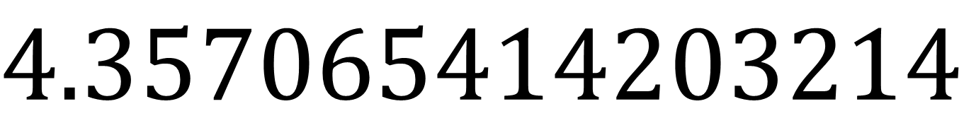
$${\left.\frac{∂}{∂x}\left(5x^{3x^{x}}\right)\right|}_{x=0.5}$$
Symbolic / analitic solution:
So, finally we can use $x=0.5$
$${\left.\frac{∂}{∂x}\left(5x^{3x^{x}}\right)\right|}_{x=0.5}={\left.15e^{3x^{x}}\left(x^{x}\ln\left(x\right)\left(\ln\left(x\right)+1\right)+x^{x−1}\right)\right|}_{x=0.5}=$$
$$4.357065414203214$$

Slide 15
The example of numerical calculations
Try solv this:
$${\left.\frac{∂}{∂x}\left(5x^{3x^{x}}\right)\right|}_{x=0.5}$$

Slide 16
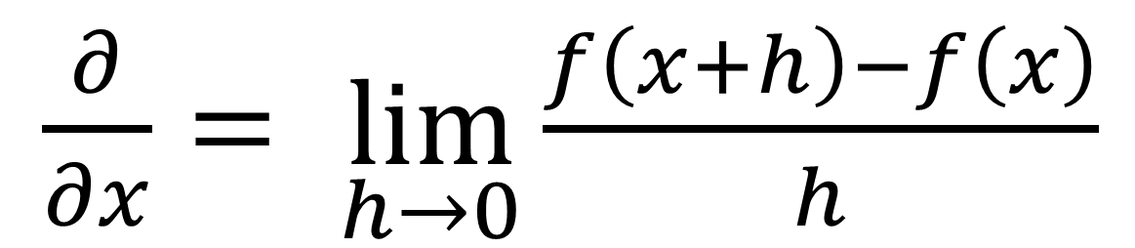
$${\left.\frac{∂}{∂x}\left(5x^{3x^{x}}\right)\right|}_{x=0.5}$$
Numerical solution
We can use the definition of the derivative as the limit of the difference quotient:
$\frac{∂}{∂x}= \lim_{h→0}{\frac{f\left(x+h\right)−f\left(x\right)}{h}}$

Slide 17
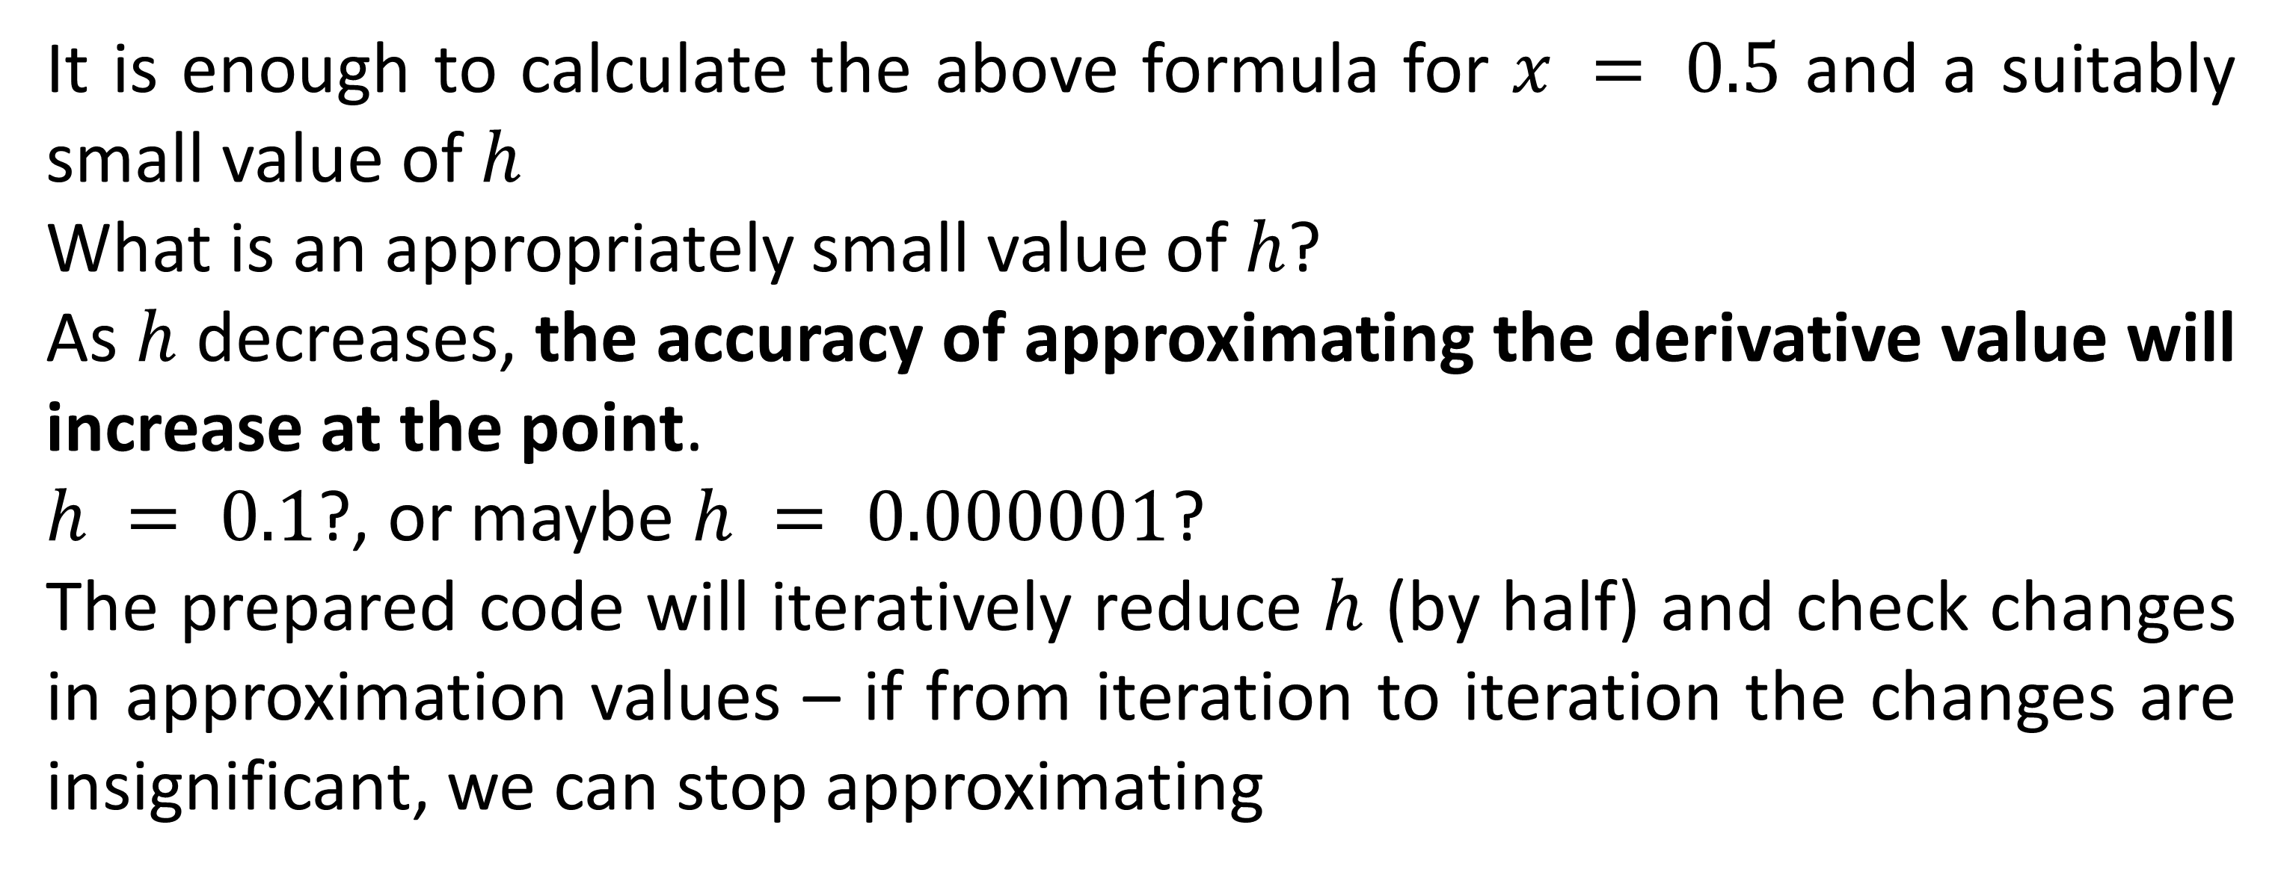
$${\left.\frac{∂}{∂x}\left(5x^{3x^{x}}\right)\right|}_{x=0.5}$$
Numerical solution
It is enough to calculate the above formula for $x = 0.5$ and a suitably small value of $h$
What is an appropriately small value of $h$?
As $h$ decreases, the accuracy of approximating the derivative value will increase at the point.
$h = 0.1$?, or maybe $h = 0.000001$?
The prepared code will iteratively reduce $h$ (by half) and check changes in approximation values – if from iteration to iteration the changes are insignificant, we can stop approximating

Slide 18
Example code 1

Slide 19

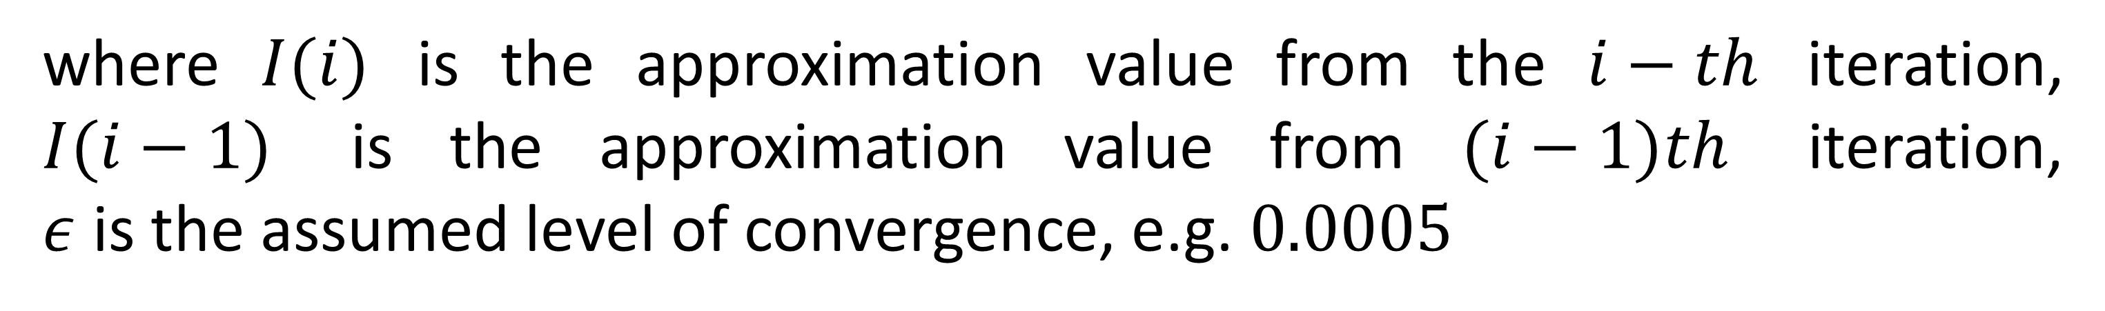
Difference quotient
loop (control variable, usually i)
stopping condition
vector or table to store results (optional, but worth it)
Typically in numerical calculation , the stopping condition is to detect that there is no change on given level of accuracy:
$$\left|I^{\left(i\right)}−I^{\left(i−1\right)}\right|≤\text{ε}$$
where $I(i)$ is the approximation value from the $i−th$ iteration, $I(i−1)$ is the approximation value from $(i−1)th$ iteration, $ε$ is the assumed level of convergence, e.g. $0.0005$

Slide 20
Example code 2

Slide 21
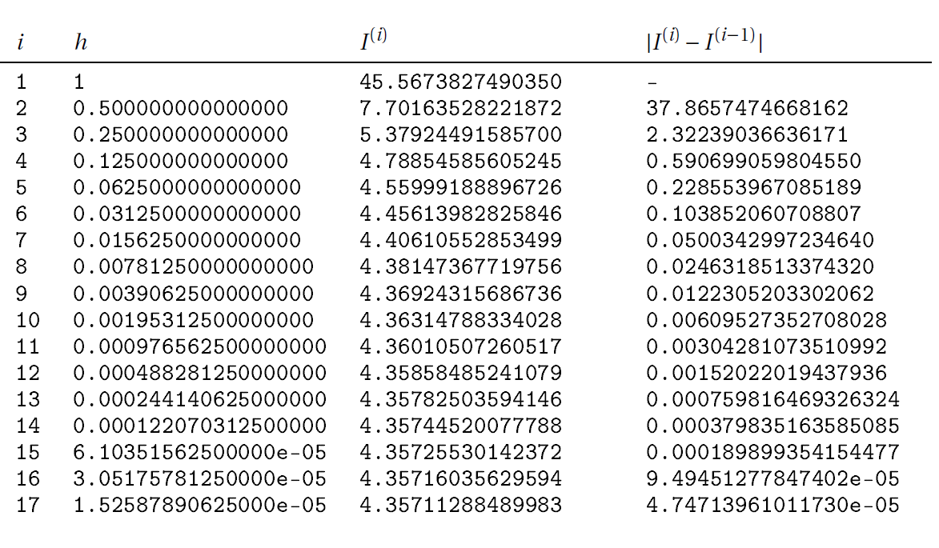
Example code 2

Slide 22
Conclusion from this example
We obtained the value of the derivative of the function at the point:
without knowing the form of the derivative function,
without the need to know the exact value of the solution.
We base this on the assumptions that:
the selected numerical method is good (after all, it is Isaac Newton),
we are satisfied with the approximate result

Slide 23
Errors in numerical calculation
As a digital device, a computer has limited numerical precision and accuracy. Computeris itself a source of error- about that on next lecture
Physical and mathematical models also describe a fragment of reality and check itoften only under certain conditions.
Accuracy – how close the calculated value is to the true value
Precision – how close a calculated/measured value is to another (calculated/measured value)

Slide 24
Precission and accuracy

Slide 25
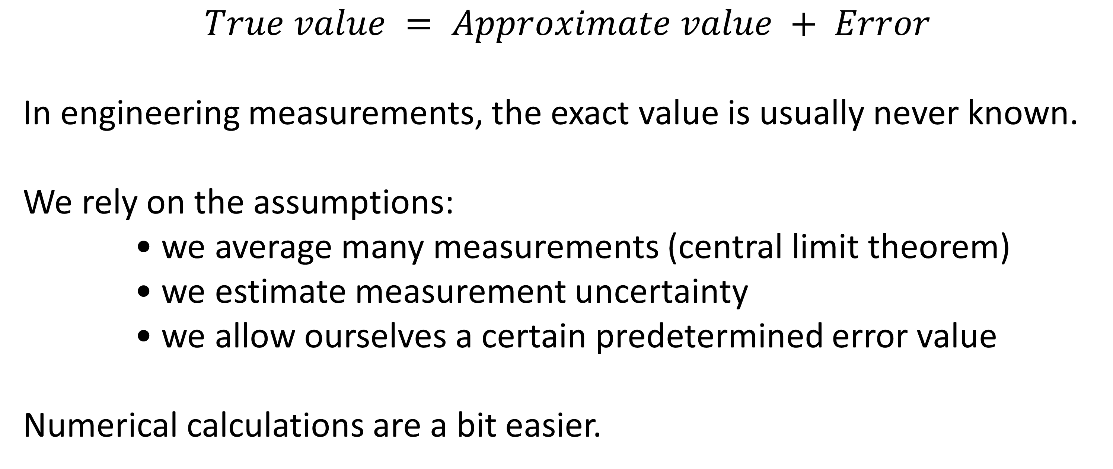
Errors definitions
$$True value = Approximate value + Error$$
In engineering measurements, the exact value is usually never known.
We rely on the assumptions:
• we average many measurements (central limit theorem)
• we estimate measurement uncertainty
• we allow ourselves a certain predetermined error value
Numerical calculations are a bit easier.

Slide 26
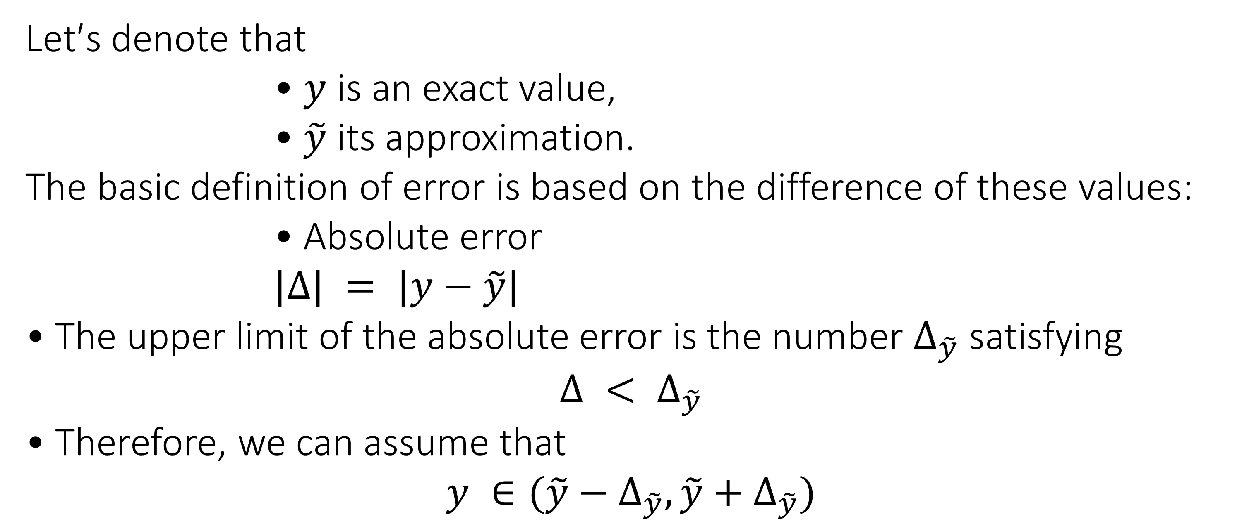
Errors definitions
Let′s denote that
• $y$ is an exact value,
• $\tilde{y}$ its approximation.
The basic definition of error is based on the difference of these values:
• Absolute error
$|Δ| = |y−\tilde{y}|$
• The upper limit of the absolute error is the number $Δ_{\tilde{y}}$ satisfying
• Therefore, we can assume that

Slide 27
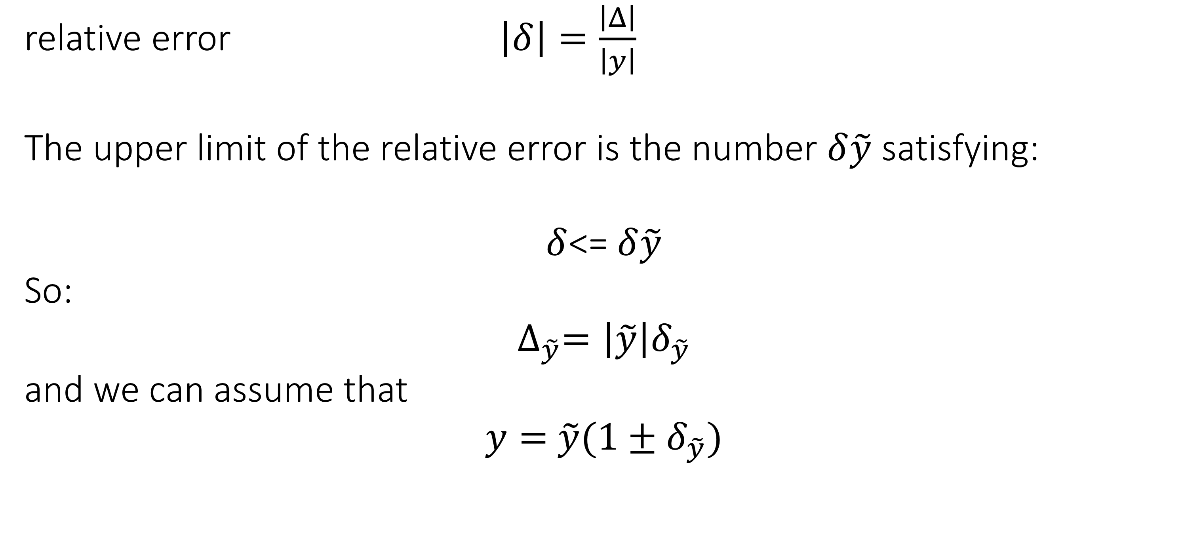
Errors definitions
relative error $\left|δ\right|=\frac{\left|Δ\right|}{\left|y\right|}$
The upper limit of the relative error is the number $δ\tilde{y}$ satisfying:
$δ$<= $δ\tilde{y}$
So:
$$∆_{\tilde{y}}=\left|\tilde{y}\right|δ_{\tilde{y}}$$
and we can assume that
$y=$ $\tilde{y}(1±δ_{\tilde{y}})$

Slide 28
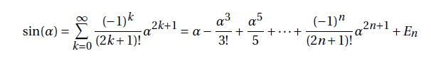
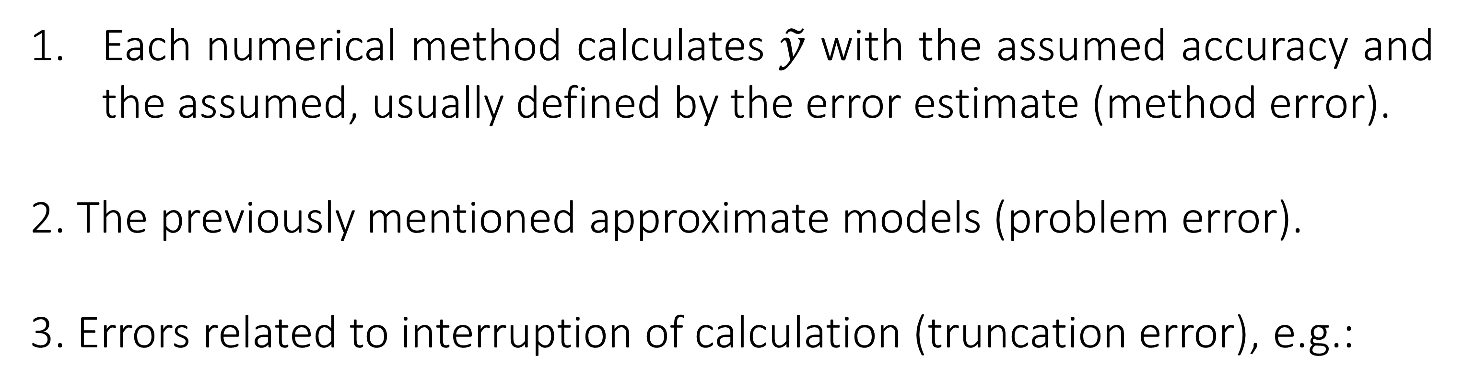
Errors types
Each numerical method calculates $\tilde{y}$ with the assumed accuracy and the assumed, usually defined by the error estimate (method error).
2. The previously mentioned approximate models (problem error).
3. Errors related to interruption of calculation (truncation error), e.g.:
where$E_{n}$is the truncation error resulting from the use of $n <∞$ terms of the series.

Slide 29
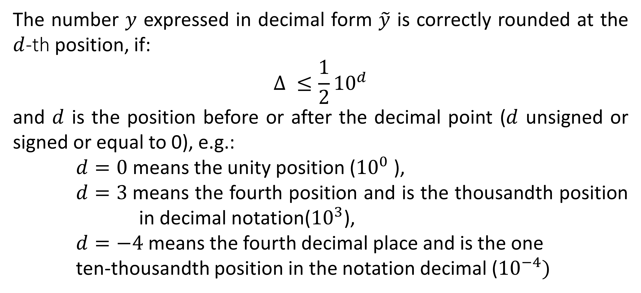
Errors types – rounding error
The number $y$ expressed in decimal form $\tilde{y}$ is correctly rounded at the $d$-th position, if:
$$Δ ≤\frac{1}{2}{10}^{d}$$
and $d$ is the position before or after the decimal point ($d$ unsigned or signed or equal to 0), e.g.:
$d=0$ means the unity position (${10}^{0}$ ),
$d=3$means the fourth position and is the thousandth position in decimal notation(${10}^{3}$),
$d=−4$means the fourth decimal place and is the one ten-thousandth position in the notation decimal (${10}^{−4})$

Slide 30
Errors types – rounding error
The number $y$ expressed in decimal form $\tilde{y}$ is correctly rounded at the $d$-th position, if:
$$Δ ≤\frac{1}{2}{10}^{d}$$
and $d$ is the position before or after the decimal point ($d$ unsigned or signed or equal to 0), e.g.:
$d=0$ means the unity position (${10}^{0}$ ),
$d=3$means the fourth position and is the thousandth position in decimal notation(${10}^{3}$),
$d=−4$means the fourth decimal place and is the one ten-thousandth position in the notation decimal (${10}^{−4})$

Slide 31
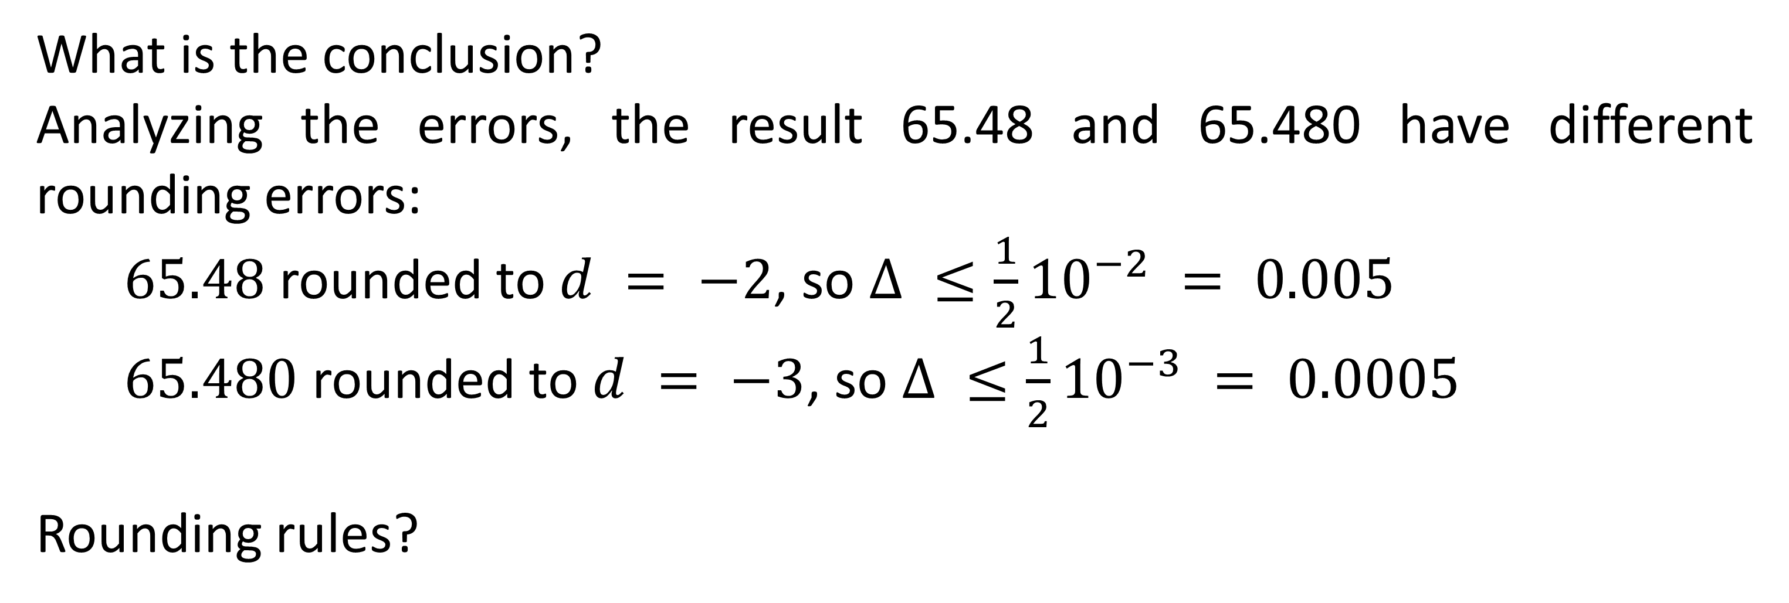
Errors types – rounding error
What is the conclusion?
Analyzing the errors, the result 65.48 and 65.480 have different rounding errors:
$65.48$ rounded to $d = −2$, so $Δ ≤\frac{1}{2}{10}^{−2} = 0.005$
$65.480$ rounded to $d = −3$, so $Δ ≤\frac{1}{2}{10}^{−3} = 0.0005$
Rounding rules?

Slide 32
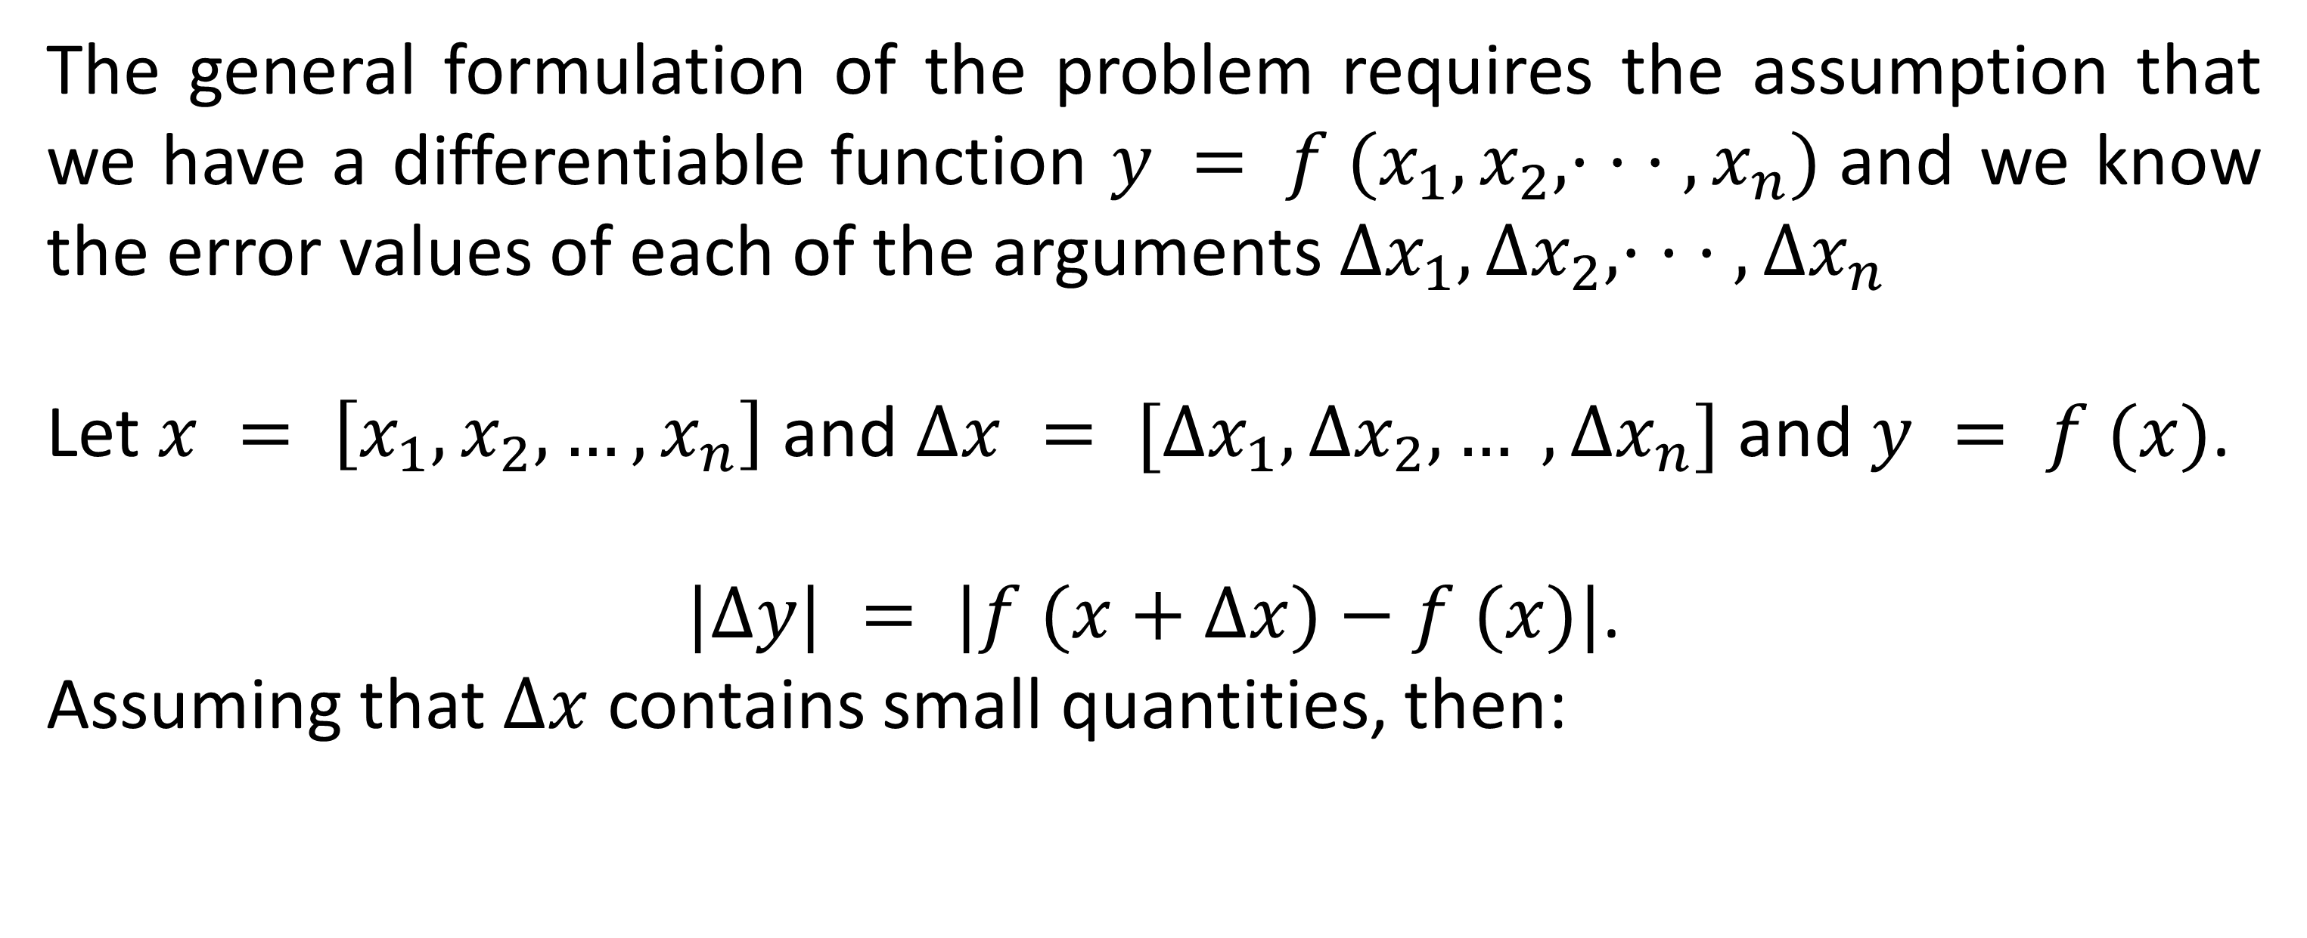
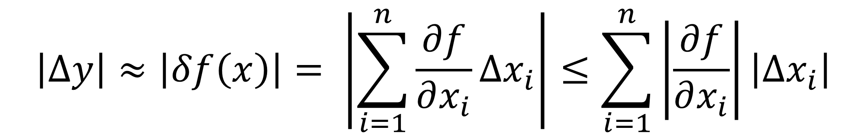
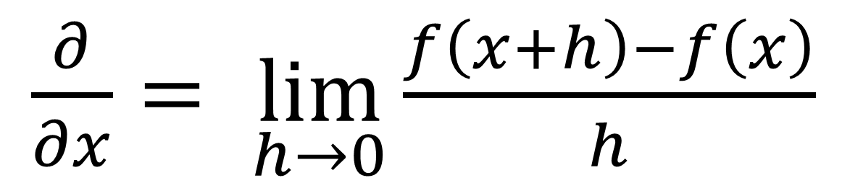
$\frac{∂}{∂x}= \lim_{h→0}{\frac{f\left(x+h\right)−f\left(x\right)}{h}}$
Error calculation
The general formulation of the problem requires the assumption that we have a differentiable function $y = f (x_{1}, x_{2}, · · · , x_{n})$and we know the error values of each of the arguments $Δx_{1}, Δx_{2}, · · · , Δx_{n}$
Let $x = \left[x_{1}, x_{2}, …, x_{n}\right]$and $Δx = [Δx_{1}, Δx_{2}, … , Δx_{n}]$ and $y = f (x)$.
$|Δy| = |f (x+Δx)−f (x)|$.
Assuming that $Δx$ contains small quantities, then:
$$\left|∆y\right|≈\left|δf\left(x\right)\right|= \left|\sum_{i=1}^{n}{\frac{∂f}{∂x_{i}}∆x_{i}}\right|≤\sum_{i=1}^{n}{\left|\frac{∂f}{∂x_{i}}\right|\left|∆x_{i}\right|}$$

Slide 33
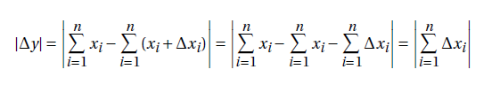
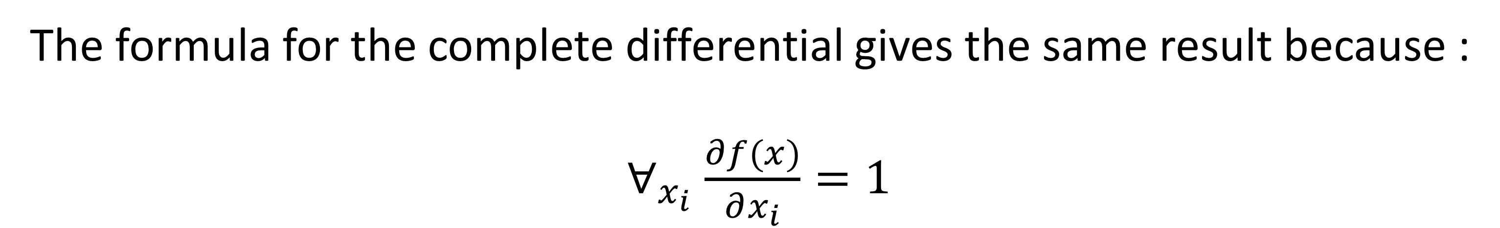
$\frac{∂}{∂x}= \lim_{h→0}{\frac{f\left(x+h\right)−f\left(x\right)}{h}}$
Error calculation
If $y=f\left(x\right)=\sum_{i=1}^{n}{x_{i} }so$
The formula for the complete differential gives the same result because :
$∀_{x_{i}}$ $\frac{∂f(x)}{∂x_{i}}=1$

Slide 34
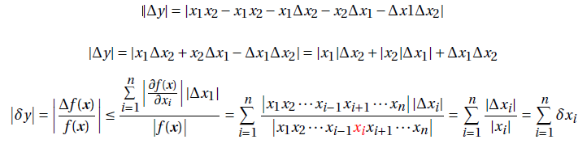
$\frac{∂}{∂x}= \lim_{h→0}{\frac{f\left(x+h\right)−f\left(x\right)}{h}}$
Error calculation
If $y=f\left(x\right)=\prod_{i=1}^{n}{x_{i}} so$
let's assume $n = 2$

Slide 35
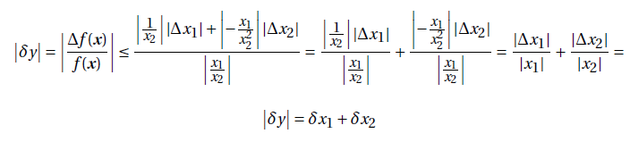
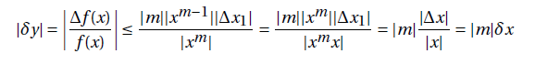
$\frac{∂}{∂x}= \lim_{h→0}{\frac{f\left(x+h\right)−f\left(x\right)}{h}}$
Error calculation
If $y=f\left(x\right)=\frac{x_{1}}{x_{2}} so$
If $y=f\left(x\right)=x^{m} so$

Slide 36
f(x)=exp(x*x) x=0.5 f’(x)=? h =1
f(x)=cos(x*x)
f(x)=(1-x*x)/(1+x*x),
f(x)=2*x*exp(sin(x))
f(x)=sin(x*x)

